Slide 1
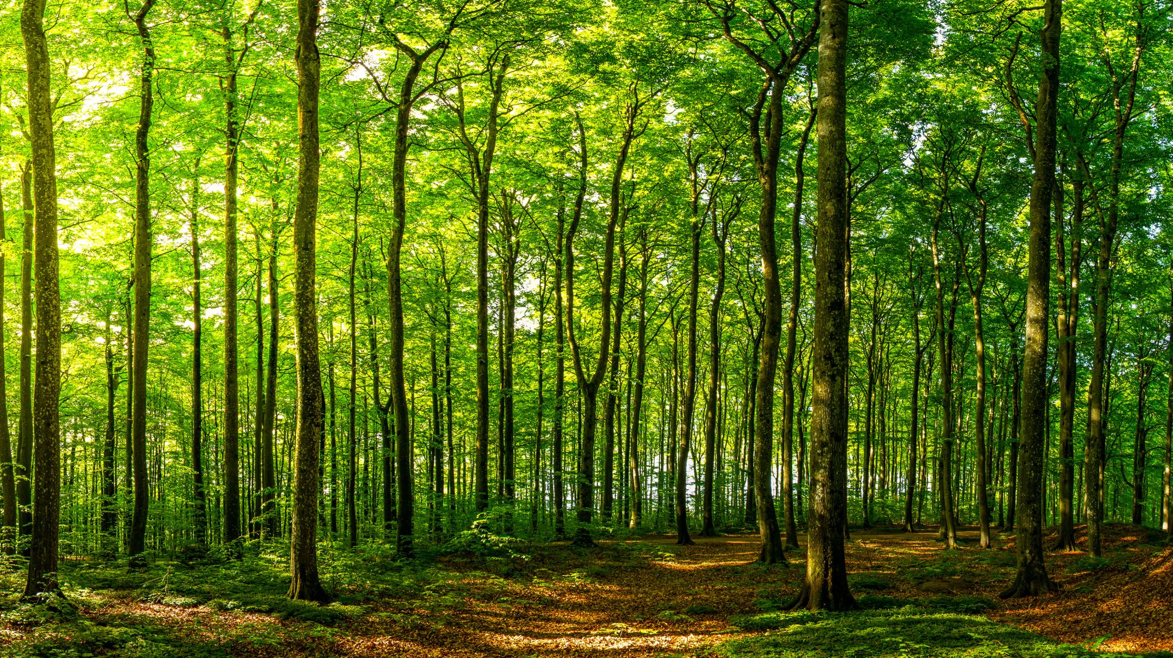
Random Forest

Slide 2
Introduction
It is a supervised machine learning algorithm
It can be used for both Classification and Regression problems in ML
A Random Forest is just a bunch of Decision Trees.
Random forest is the solution to overfitting problem of decision tree

Slide 3
It is based on the concept of ensemble learning
Makes multiple decision tree and based on the majority votes of predictions, and it predicts the final output.
The greater number of trees in the forest leads to higher accuracy and prevents the problem of overfitting.

Slide 4
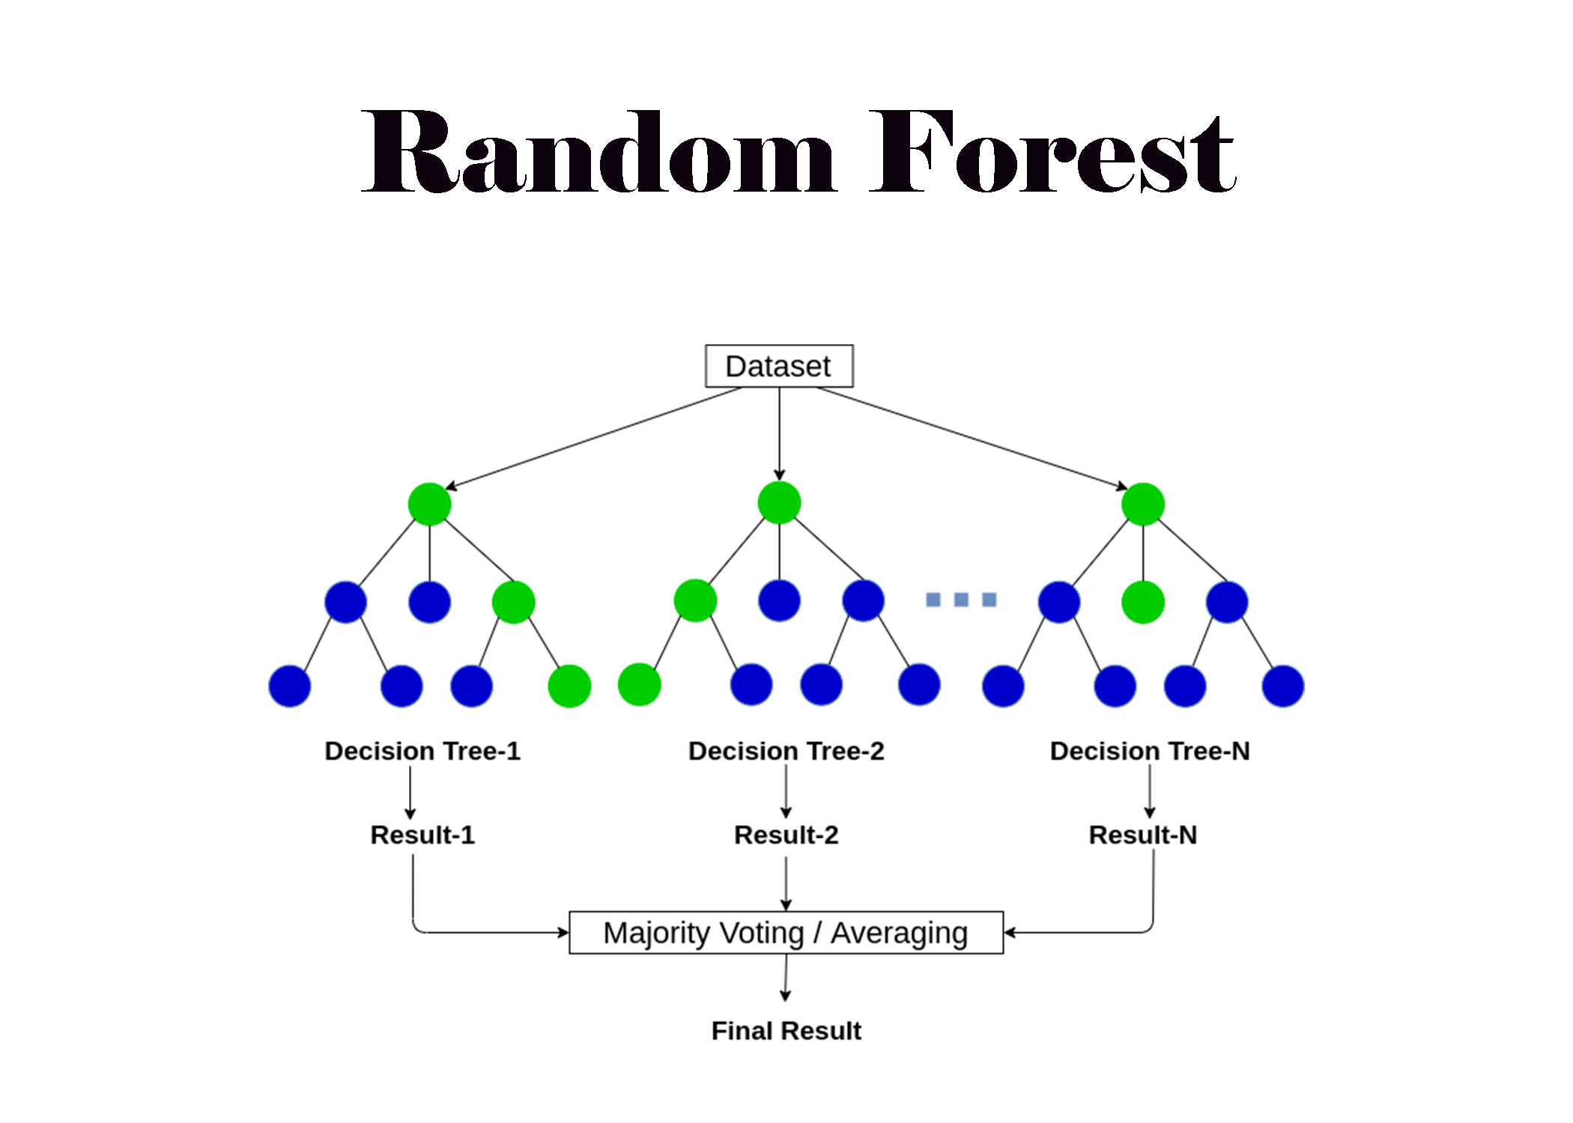

Slide 5
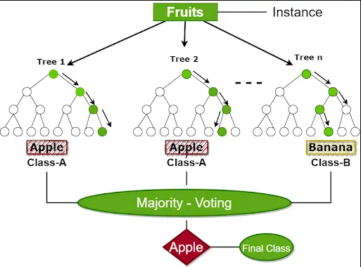

Slide 6
Ensemble learning
Ensemble learning helps improve machine learning results by combining several models.
We can use these techniques for regression as well as classification problems.
The final prediction from these ensembling techniques is obtained by combining results from several base models.
Averaging, voting and stacking are some of the ways the results are combined to obtain a final prediction

Slide 7
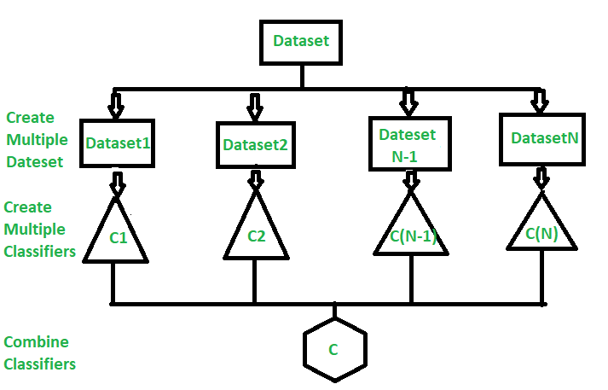

Slide 8
Working Mechanism Random Forest Algorithm
Selecting random samples from the training set or data
The algorithm constructs a particular decision tree for training data
Voting occurs by averaging a decision tree
Now, it comes to selecting the voted prediction results as the ultimate prediction result

Slide 9
Example
list of parameters that you should consider before buying a house:
Price of the house
Locality
Number of bedrooms
Parking space
Available facilities

Slide 10
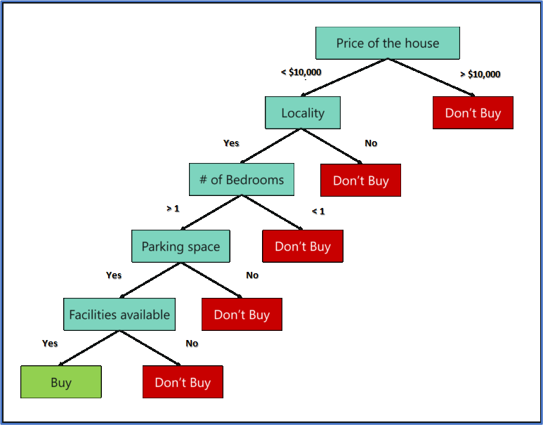
Decision tree for buying a house
Decision trees are built on the entire data set by using all the predictor variables.

Slide 11
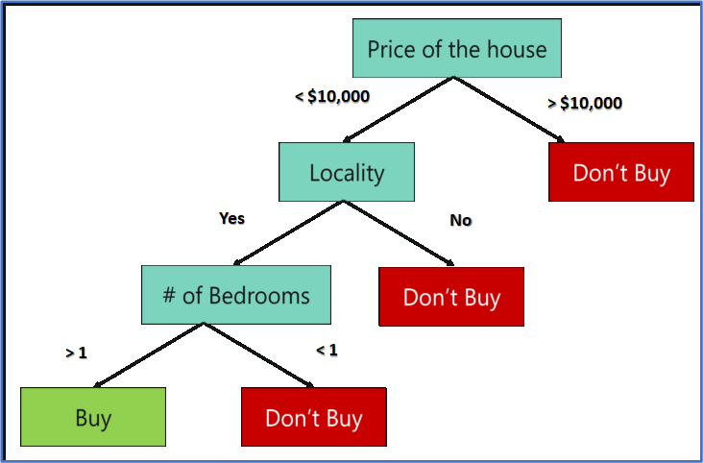
Random Forest for buying a house
It randomly selects a set of parameters and creates a decision tree for each set of chosen parameters.

Slide 12
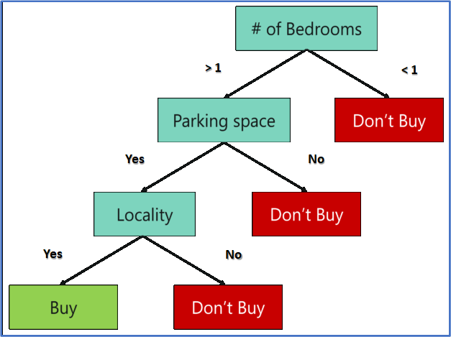

Slide 13
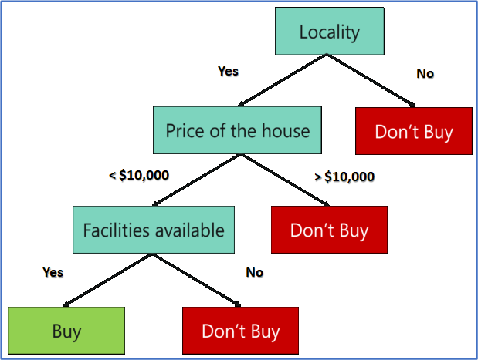

Slide 15
Each decision tree only takes three parameters
Each decision tree predicts the outcome based on the respective predictor variables
takes the average of the results from all the decision trees in the random forest.

Slide 16
Important Hyperparameters
Hyperparameters to enhance the predictive power
n_estimators: Number of trees built by the algorithm before averaging the products.
max_features: Maximum number of features random forest uses before considering splitting a node.
mini_sample_leaf: Determines the minimum number of leaves required to split an internal node.

Slide 17
hyperparameters to increase the speed of the model
n_jobs: Conveys to the engine how many processors are allowed to use. If the value is 1, it can use only one processor, but if the value is -1,, there is no limit.
random_state: Controls randomness of the sample. The model will always produce the same results if it has a definite value of random state and if it has been given the same hyperparameters and the same training data.

Slide 18
oob_score: OOB (Out Of the Bag) is a random forest cross-validation method. In this, one-third of the sample is not used to train the data but to evaluate its performance.

Slide 19
Advantages of Random Forest
Random Forest can perform both Classification and Regression tasks.
It is capable of handling large datasets with high dimensionality.
It enhances the accuracy of the model and prevents the overfitting issue.

Slide 20
Disadvantages of Random Forest
Although random forest can be used for both classification and regression tasks, it is not more suitable for Regression tasks.

Slide 21
Thank You

